Slide 1
CARE
CIRCLE
Arehone Rahulani
Salem Hernandez
Daniel Christian Mulomba
Consolate Mpanga
Jai Sainani
ByteBakers

Slide 2
OBJECTIVE
To provide parents with fast and secure access to verified, trustworthy nannies.
Integrate family-friendly local restaurants, parks, events and other activities.
To create a safe platform supported by background checks.
Establish Care Circle as a trusted childcare and family experience ecosystem on the Eastside.
2

Slide 3
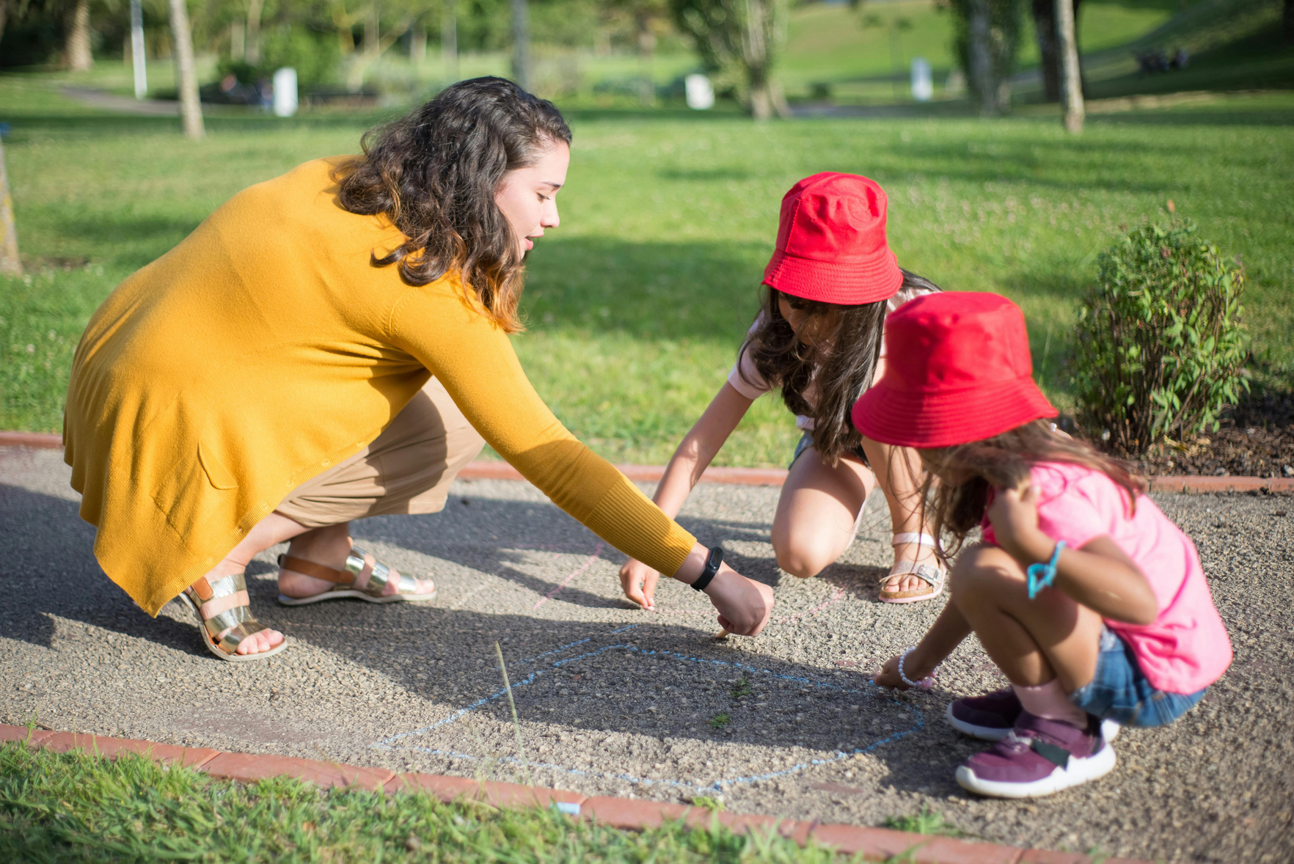
ABOUT US
Care Circle is a Modern childcare platform designed for families in the Seattle, Bellevue, Kirkland and Redmond areas. We help parents connect with trusted, verified nannies while discovering family-friendly restaurants, parks and activities nearby in all one simple experience.
At Care Circle, our mission is to make childcare safe, transparent and stress-free. Parents deserve a piece of mind and caregivers deserve a platform that highlights their skills, experience and passion for childcare. That is why Care Circle combines real background checks (powered by checkr), location-based search tools and clear, easy to read nanny profiles to help families make confident decisions.
We believe in community.
We believe in safety.
We believe childcare should be easier
Whether you’re a busy paren searching for a reliable nanny or a caregiver looking to connect with great families, Care Circle is here to support your journey with trust, convinience and care at the center of everything we do.
3

Slide 4



Amina Kiba
Jessica
Jordan Lee
Caregiver
Restaurant owner
Caregiver
4

Slide 5
COMMON CHALLENGES
Problems
Finding trusted, verified nannies quickly
Balancing childcare and family activities without stress
Knowing which restaurants/parks are kid friendly
Lack of central platform combining childcare and family outings
Causing
Wasted time
Safety concerns
Stressful planning
Inconsistent childcare
5

Slide 6



SOLUTION
Connects parents with verified nannies
Uses checkr for background screening
Integrates Google Maps API for local family-friendly places
Young couples can find things to do on date night
Shows ratings, reviews, and safety info
Offers real time availability
Restaurants, activities, events, parks recommendations =
6

Slide 7
WHY ?
The Eastside has:
Parents who rely on childcare
High demand for safe, reliable childcare
A growing population of young families
A booming market for family-friendly local discovery
7

Slide 8

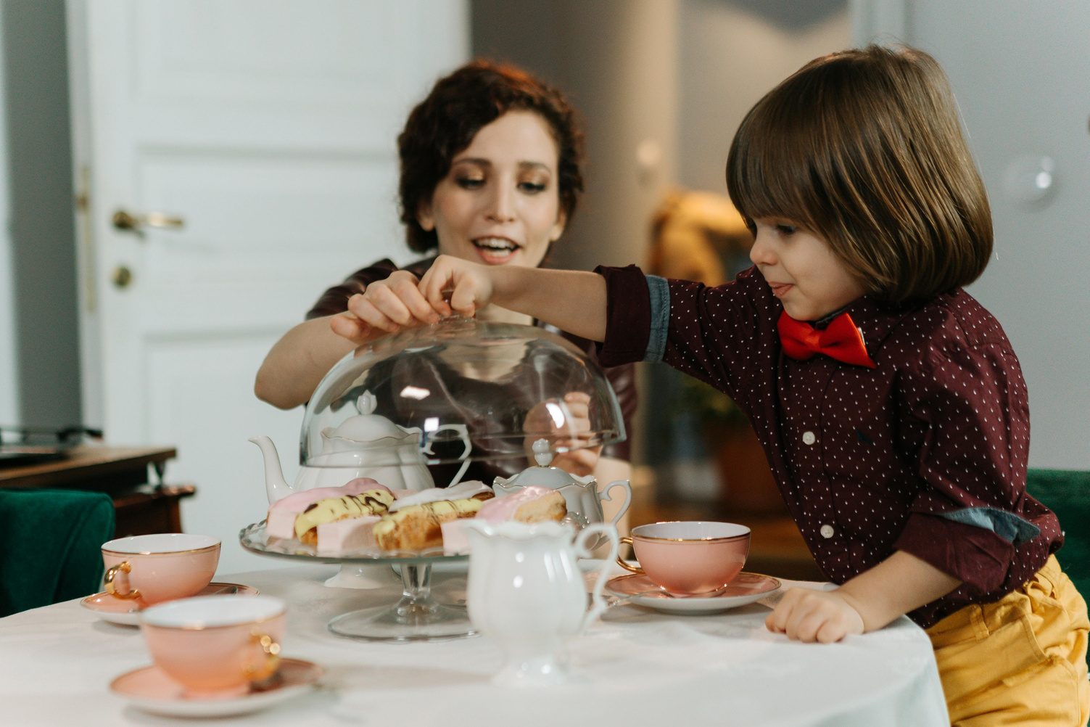
TARGET AUDIENCE
Parents aged between 25-45
Seattle, Bellevue, Kirkland, Reedmond
Working Professionals
Middle- high income households
Tech savvy families who prefer convenience and safety
8

Slide 9

KEY FEATURES
Childcare
Nanny profiles
Verification
Experience, certifications, age groups
Reviews and ratings
Favorites list
Quick-book option
Family Friendly Discovery
Restaurants
Indoor activities
Safety ratings
Kid menus
Stroller accessibility
Playgrounds
9

Slide 10
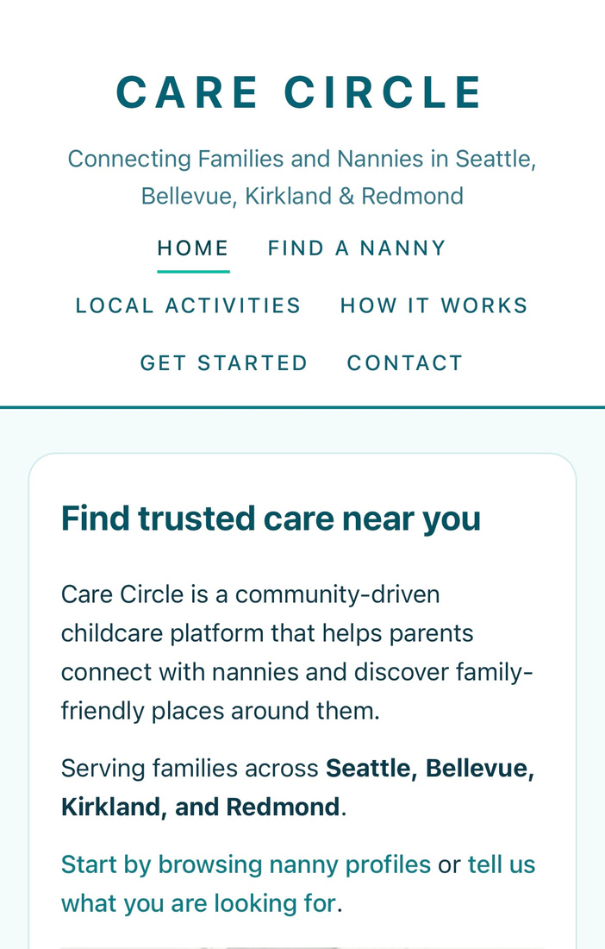
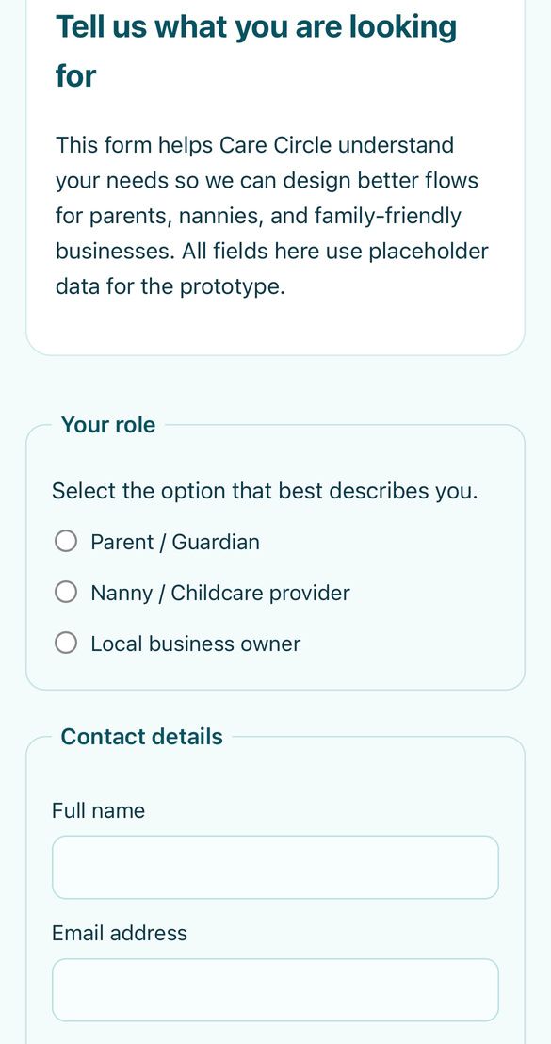
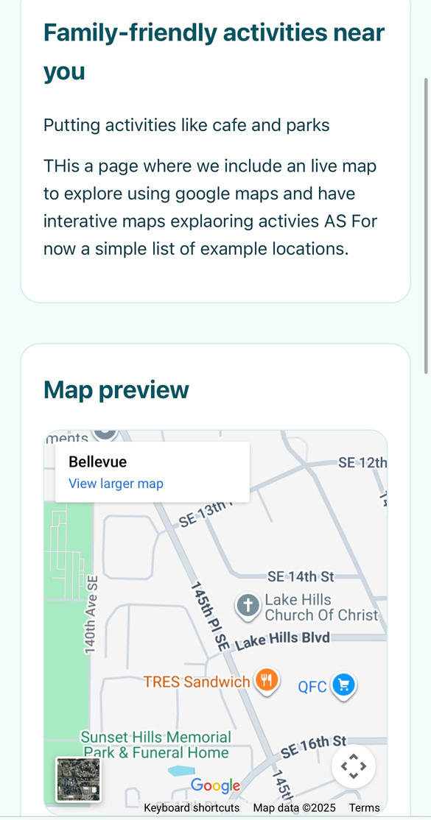
WIREFRAMES
9

Slide 11
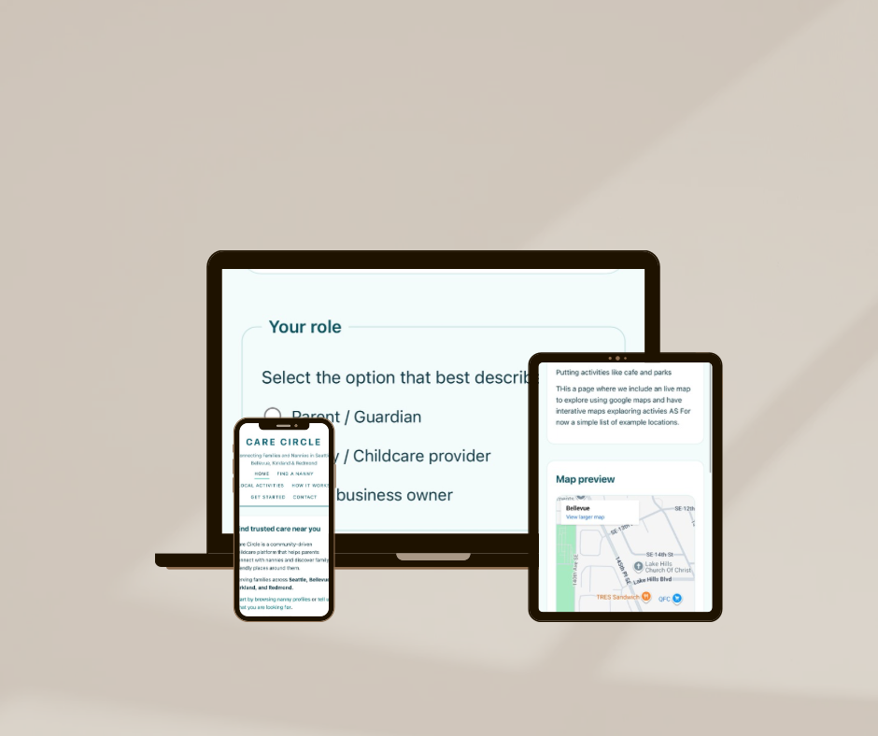
MOCKUPS
9

Slide 12


FUTURE ROADMAP
In-app payments
Meal-prep partnership
Group nanny sharing
Child development tips
Loyalty rewards with restaurants
9

Slide 13
THE END

